Slide 1
Machine Learning Interviews
Chip Huyen (@chipro)
chip@huyenchip.com

Slide 2
Slides posted on
Twitter @chipro

Slide 3






My background
Writing
Product
AI/ML
Cốc Cốc browser
20M+ monthly active users
Baomoi.com
acquired by VNG
Youth Asia
acquired by Groupon

Slide 4
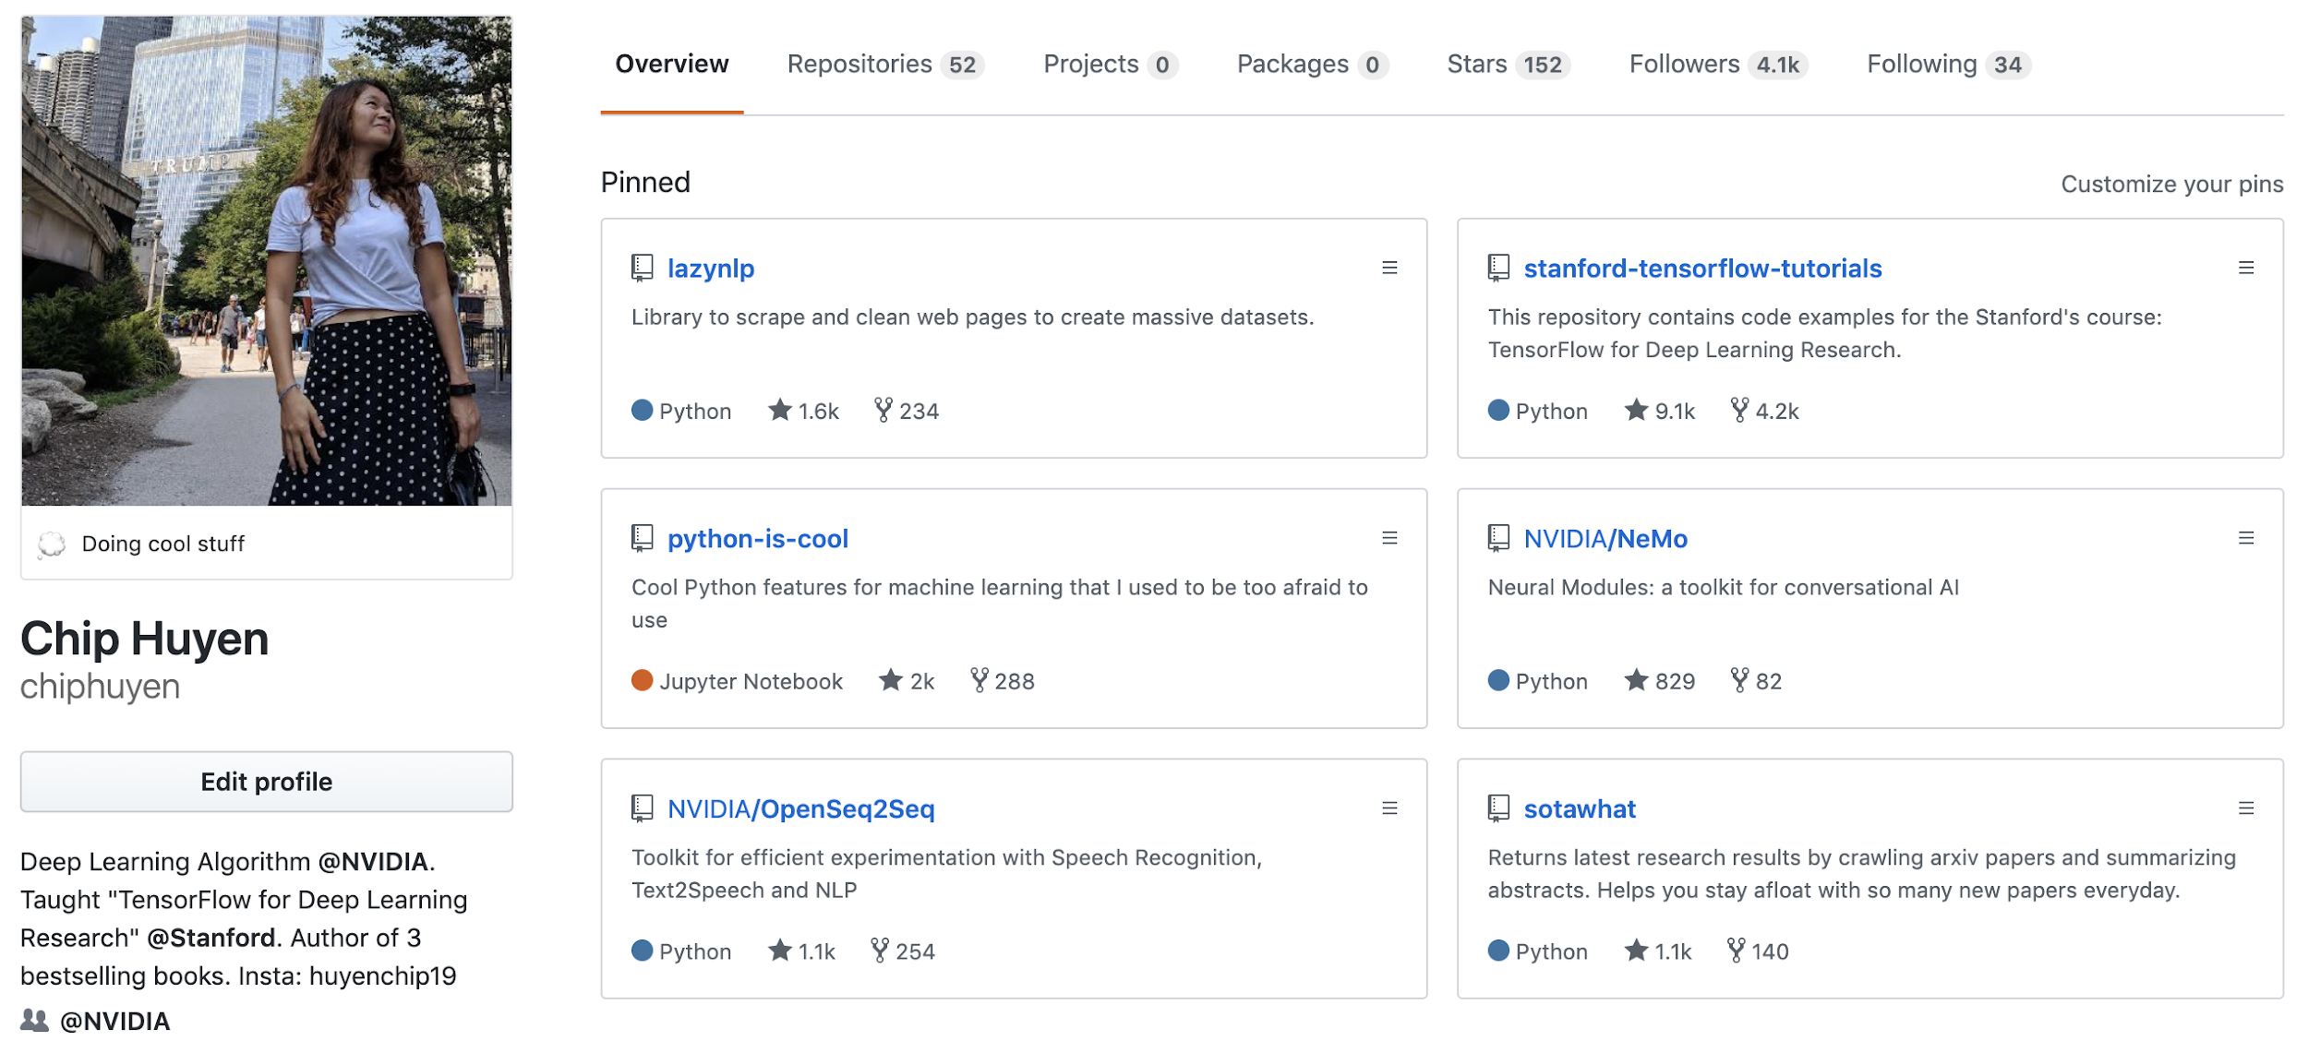
My work (very pro-OSS)

Slide 5
Contents
Machine learning jobs
Getting a job in ML
Understanding the interviewers’ mindset
Interview process
Recruiting pipeline

Slide 6
Machine learning jobs

Slide 7
Research vs applied research
Research scientist vs research engineer
Data scientist vs machine learning engineer

Slide 8
Research | Applied research
Find the answers for fundamental questions and expand the body of theoretical knowledge. | Find solutions to practical problems
Ex: develop a new learning method for unsupervised transfer learning | Ex: develop techniques to make that new learning method work on a real world dataset
Focus on long term outcome | Focus on immediate commercial outcome
Caveats
Cutting-edge research is spearheaded by big corporations
Lacking theories to explain methods that work well empirically
Notes:
Research solutions should work for practical problems
Solving practical problems often requires coming up with novel ideas

Slide 9
Research scientist | Research engineer
Develop original ideas | Use engineering to actualize these ideas
Might require PhDs | Don’t require PhDs
Might act as an advisor to research engineers | Springboard to become research scientist
Caveats
Depends on organizations/teams. In some teams, there are virtually no difference
Scientists & engineers can be equal first authors (e.g. GPT-2, Transformer paper)

Slide 10
Data scientist | ML Engineers
Extract knowledge and insights from structured and unstructured data | ML models learn from data -> ML is part of data science
Use data to help company make decisions | Develop models to turn data into products
Is a scientist -> engineering isn’t a top priority | Is an engineer -> engineering is a top priority
Caveats
MLEs at startups might spend most of their time wrangling data, understanding data, setting up infrastructure, and deploying models instead of training ML models.

Slide 11
Machine Learning Engineer (MLE)
Umbrella term to cover:
research engineer
devrel engineer
data scientist
deep learning engineer
generic machine learning engineer
It does not cover:
ML DevOps
framework engineer

Slide 12
ML at big companies
#
ML at startups

Slide 13
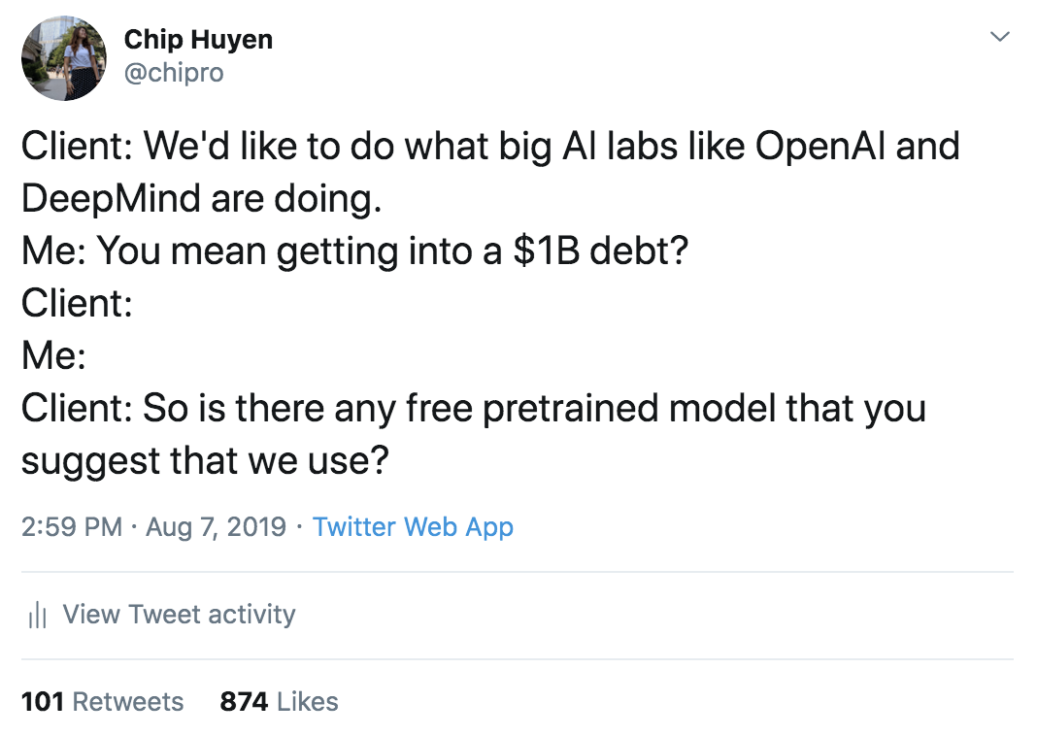
Big companies | Startups
Can afford research | Can’t (estimated cost of AlphaStar is $26M)
Notes:
AlphaStar

Slide 14
Big companies | Startups
Can afford research | Can’t (estimated cost of AlphaStar is $26M)
Can afford specialists | Need generalists
Notes:
AlphaStar

Slide 15
Big companies | Startups
Can afford research | Can’t (estimated cost of AlphaStar is $26M)
Can afford specialists | Need generalists
Standardized process | Make up process as they go
Notes:
AlphaStar

Slide 16
Getting a job in ML

Slide 17
Six common paths
BS/MS in ML -> ML engineer
Tech Ivies -> FAANG/startups

Slide 18
Six common paths
BS/MS in ML -> ML engineer
PhD in ML -> ML researcher
Published at top-tier conferences -> FAANG/ML-first startups
Notes:
Adjacent fields: stats, physics, math
Unrelated fields: health, art, agriculture,

Slide 19
Six common paths
BS/MS in ML -> ML engineer
PhD in ML -> ML researcher
Data scientist -> on-job training -> ML engineer/researcher
Companies want to start using ML
Notes:
Adjacent fields: stats, physics, math
Unrelated fields: health, art, agriculture,

Slide 20
Six common paths
BS/MS in ML -> ML engineer
PhD in ML -> ML researcher
Data scientist -> on-job training -> ML engineer/researcher
Software engineer -> courses -> ML engineer
Software engineers want to transition into ML

Slide 21
Six common paths
BS/MS in ML -> ML engineer
PhD in ML -> ML researcher
Data scientist -> on-job training -> ML engineer/researcher
Software engineer -> courses -> ML engineer
Adjacent fields -> on-job training -> ML researcher
Not enough talents from AI/ML PhDs
Ex: stats, physics, math
Notes:
Adjacent fields:

Slide 22
Six common paths
BS/MS in ML -> ML engineer
PhD in ML -> ML researcher
Data scientist -> on-job training -> ML engineer/researcher
Software engineer -> courses -> ML engineer
Adjacent fields -> on-job training -> ML researcher
Unrelated fields -> residency/fellowship -> ML researcher
Big companies: Google, Facebook, MSFT, NVIDIA, etc.
Ex: health, art, architecture, agriculture

Slide 23
Avoid anyone that promises you ML expertise in days or weeks!!

Slide 24
Senior role | Junior role
Hired for skills | Hired for attitude

Slide 25
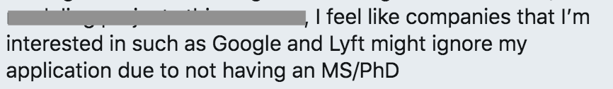
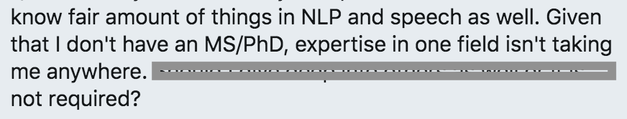
Do you need a PhD?

Slide 26
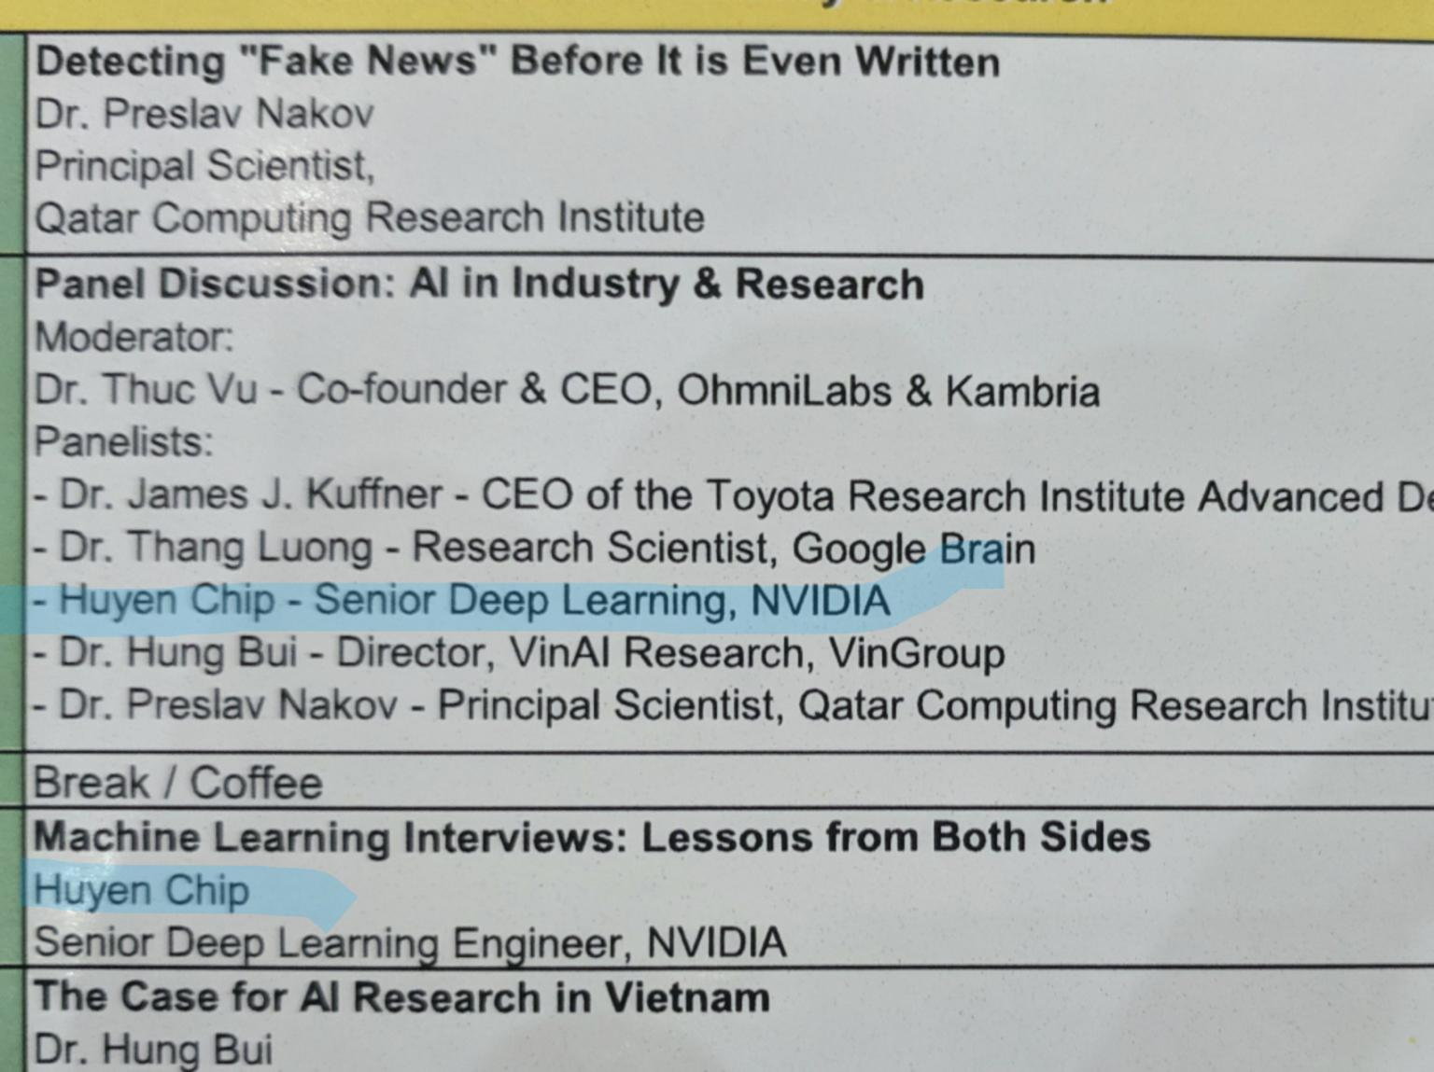
Do you need a PhD?

Slide 27
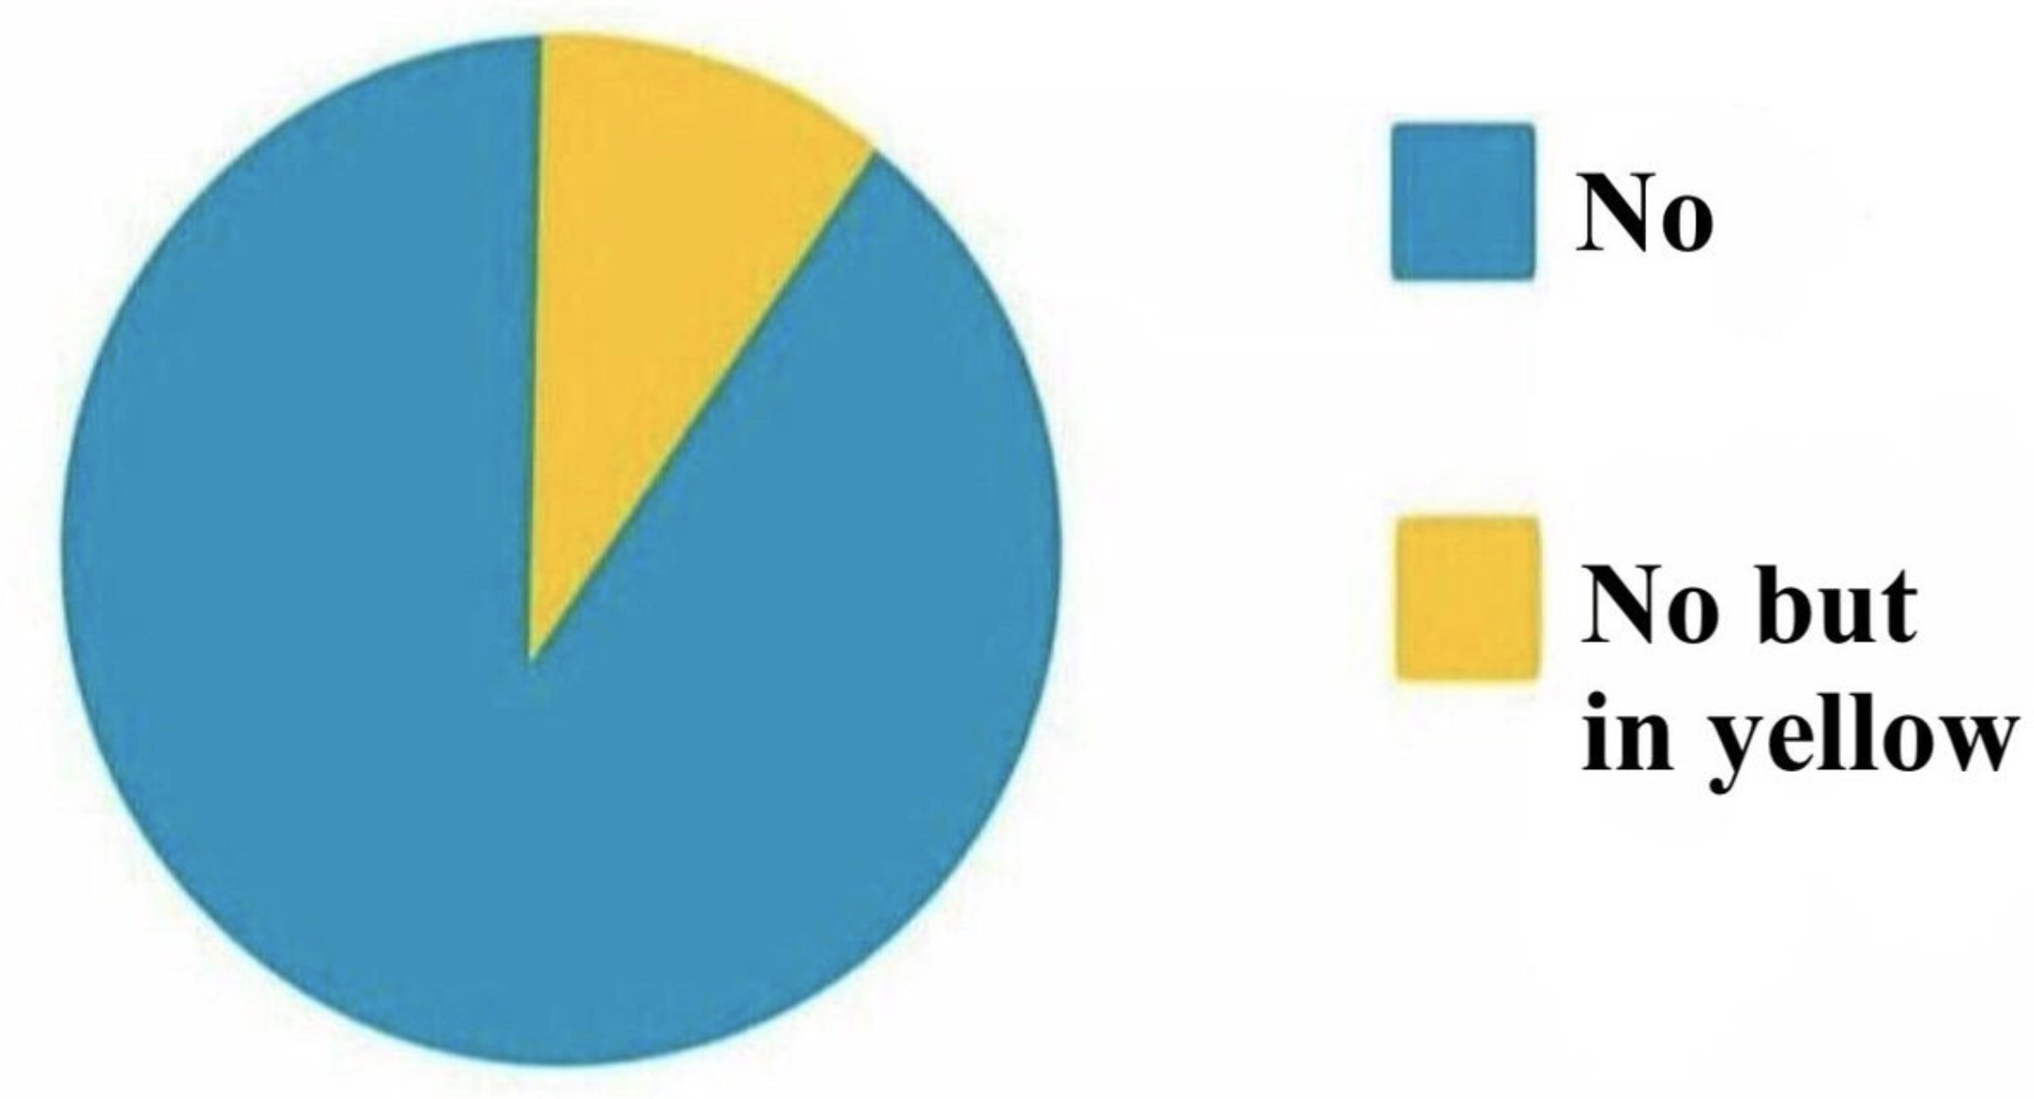
Do you need a PhD?

Slide 28
The only role that might require a PhD is (applied) research scientist
MLE jobs
MLR jobs

Slide 29
The only role that might require a PhD is (applied) research scientist
We need more engineers:
To improve research
To productize research
MLE jobs
MLR jobs

Slide 30
Understanding the interviewers’ mindset

Slide 31
Companies hate hiring
Expensive for companies
Stressful for hiring managers
Boring for interviewers

Slide 32
2. Companies don’t want the best people
They want the best people who can do a reasonable job within the time and monetary constraints.

Slide 33
3. Companies don’t know what they’re hiring for
They don’t even know for sure if they’ll need that person
-> job descriptions for reference purposes only
Notes:
Unless it’s an established team with routine tasks, hiring managers often can’t predict with perfect clarity what tasks need to get done or what skills are needed.
Sam Altman had advised companies that at the beginning, “you should only hire when you desperately need to

Slide 34
4. Most recruiters can’t evaluate technical skills
They rely on weak signals:
previous employers
degrees
awards/papers
GitHub/Kaggle
referrals

Slide 35
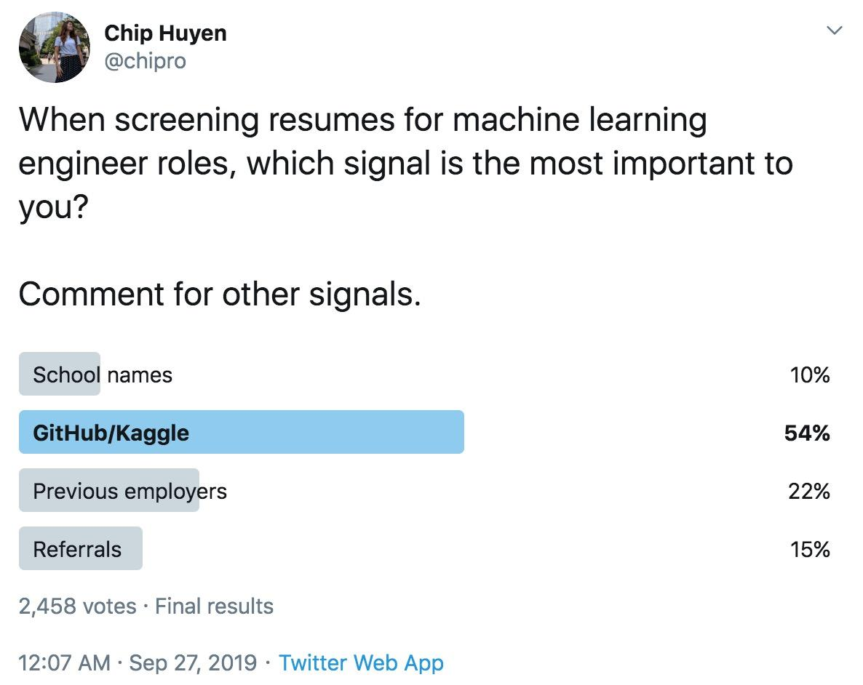
Weak signals
previous employers
degrees
awards/papers
GitHub/Kaggle
referrals

Slide 36
PSA: Past projects aren’t meritocratic
Not everyone can afford to contribute to OSS or do Kaggle competitions.
Placing too much importance on voluntary activities punishes candidates from less privileged background.
Notes:
those who work long hours, have too many responsibilities at home, or face online harassment for who they are.

Slide 37
5. Most interviewers are bad
Little or no training for interviewers even at big companies

Slide 38
6. Interview outcome depends on many random variables
It is, in no way, a reflection of your ability or your self-worth

Slide 39
Interview process

Slide 40
Interview process
Evolved out of the traditional software engineering interview process

Slide 41
Interview process
Resume screen
Phone screen
Coding challenges / take-home assignments
Technical offsite interviews (1 - 2)
Onsite interviews (4 - 8)

Slide 42
Interview process
PSA:
Take-home assignments punish less privileged candidates!!
Resume screen
Phone screen
Coding challenges / take-home assignments
Technical offsite interviews (1 - 2)
Onsite interviews (4 - 8)

Slide 43
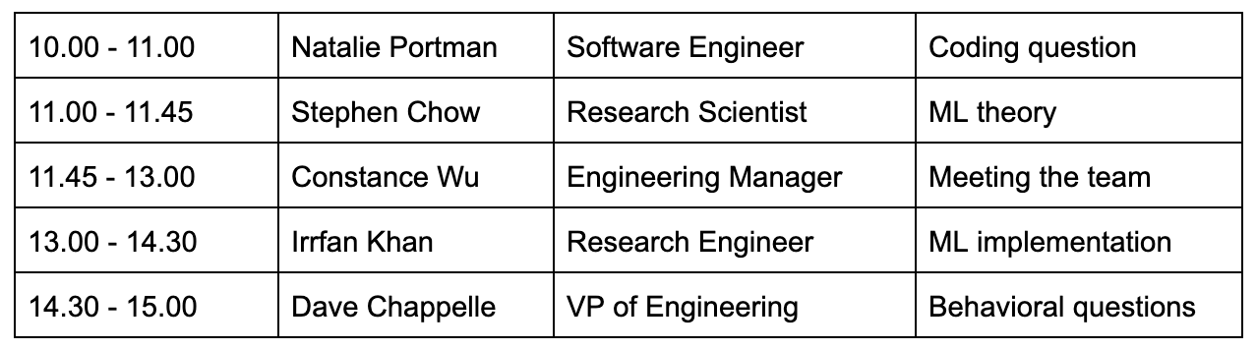
Onsites are tiring

Slide 44
Bad interview questions
Questions that ask for the retention of knowledge that can be easily looked up
“write down the equation for the Adam optimizer.”

Slide 45
Bad interview questions
Questions that ask for the retention of knowledge that can be easily looked up
Questions that evaluate irrelevant skills
“write a linked list.”

Slide 46
Bad interview questions
Questions that ask for the retention of knowledge that can be easily looked up
Questions that evaluate irrelevant skills
Questions whose solutions rely on one single insight
“take derivative of x^x.”

Slide 47
Bad interview questions
Questions that ask for the retention of knowledge that can be easily looked up
Questions that evaluate irrelevant skills
Questions whose solutions rely on one single insight
Questions that try to evaluate multiple skills at once
“explain PCA to your grandma.”

Slide 48
Bad interview questions
Questions that ask for the retention of knowledge that can be easily looked up
Questions that evaluate irrelevant skills
Questions whose solutions rely on one single insight
Questions that try to evaluate multiple skills at once
Questions that use specific hard-to-remember names
“Moore–Penrose inverse” or “Frobenius norm”

Slide 49
Bad interview questions
Questions that ask for the retention of knowledge that can be easily looked up
Questions that evaluate irrelevant skills
Questions whose solutions rely on one single insight
Questions that try to evaluate multiple skills at once
Questions that use specific hard-to-remember names
Open-ended questions with one expected answer

Slide 50
Bad interview questions
Questions that ask for the retention of knowledge that can be easily looked up
Questions that evaluate irrelevant skills
Questions whose solutions rely on one single insight
Questions that try to evaluate multiple skills at once
Questions that use specific hard-to-remember names
Open-ended questions with one expected answer
Easy questions during later interview rounds
“find the longest common subsequence.”

Slide 51
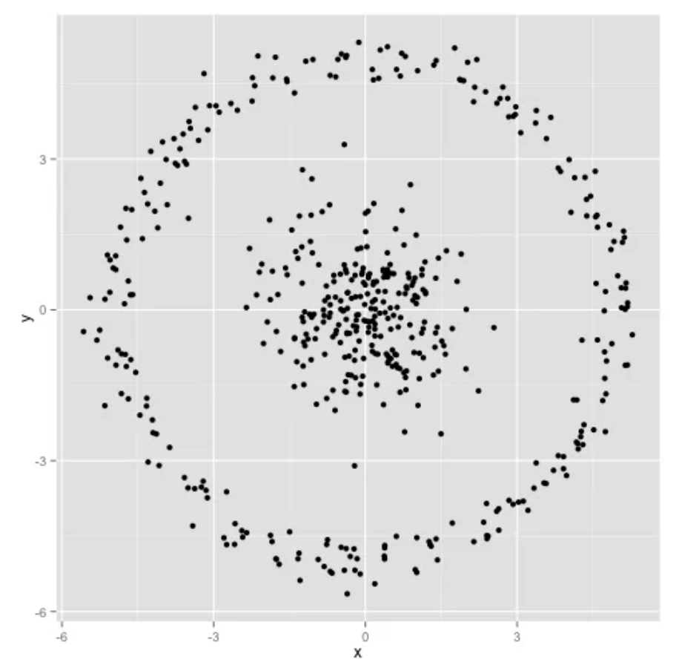
Examples of good interview questions
Given the following dataset, can you predict how K-means clustering works on it? Explain.

Slide 52
Examples of good interview questions
Imagine you have to train a NER model on the text corpus A. Would you make A case-sensitive or not?

Slide 53
Examples of good interview questions
Duolingo is a platform for language learning. When a student is learning a new language, Duolingo wants to recommend increasingly difficult stories to read.
How would you measure the difficulty level of a story?
Given a story, how would you edit it to make it easier or more difficult?

Slide 54
Alternative interview formats
Multiple choice quiz
Quiz
Code debugging
Pair programming
Good cop, bad cop

Slide 55
Recruiting pipeline

Slide 56

Onsite-to-offer ratio
Offer yield rate

Slide 57
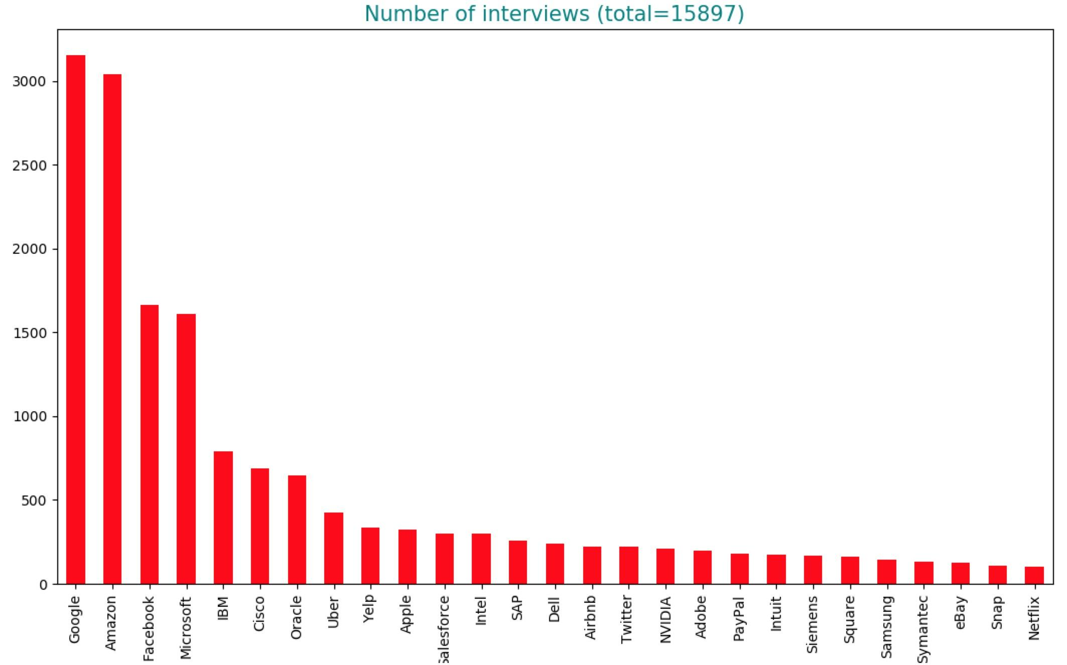
15,897 Glassdoor interview reviews
27 major tech companies

Slide 58
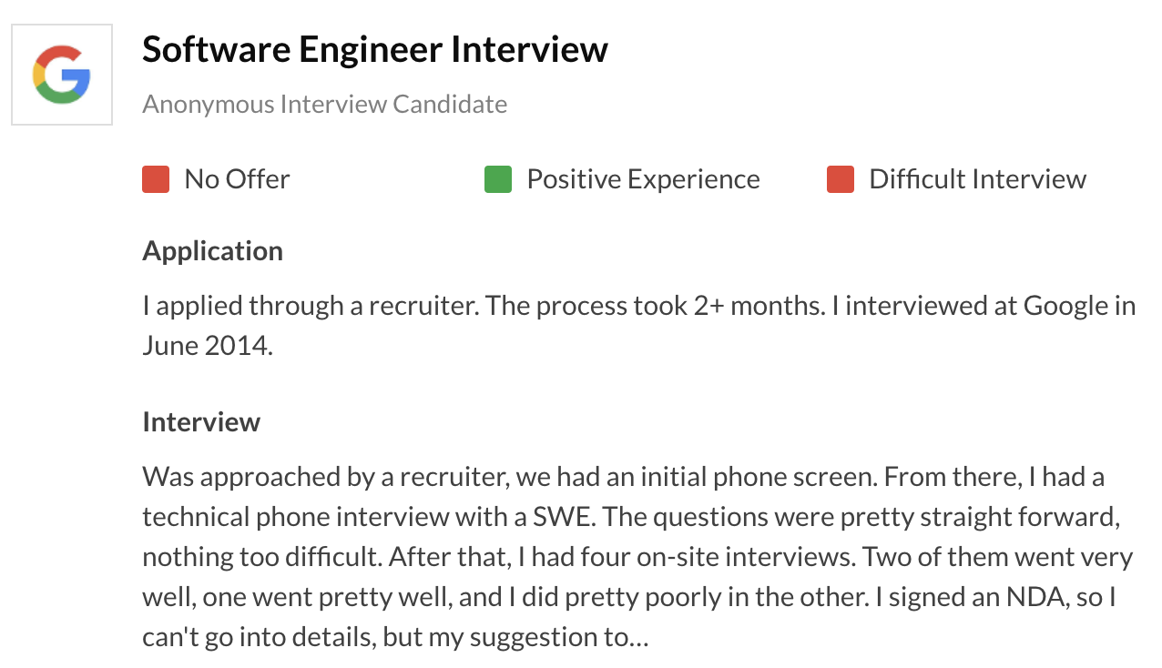
Result
Experience
Difficulty

Slide 59
Biases
few people leave reviews for anything online
reviews are likely compelled by either a really good or really bad experience
those who receive offers are more likely to give reviews than those who don’t
those who accept offers are more likely to give reviews than those who decline
...

Slide 60
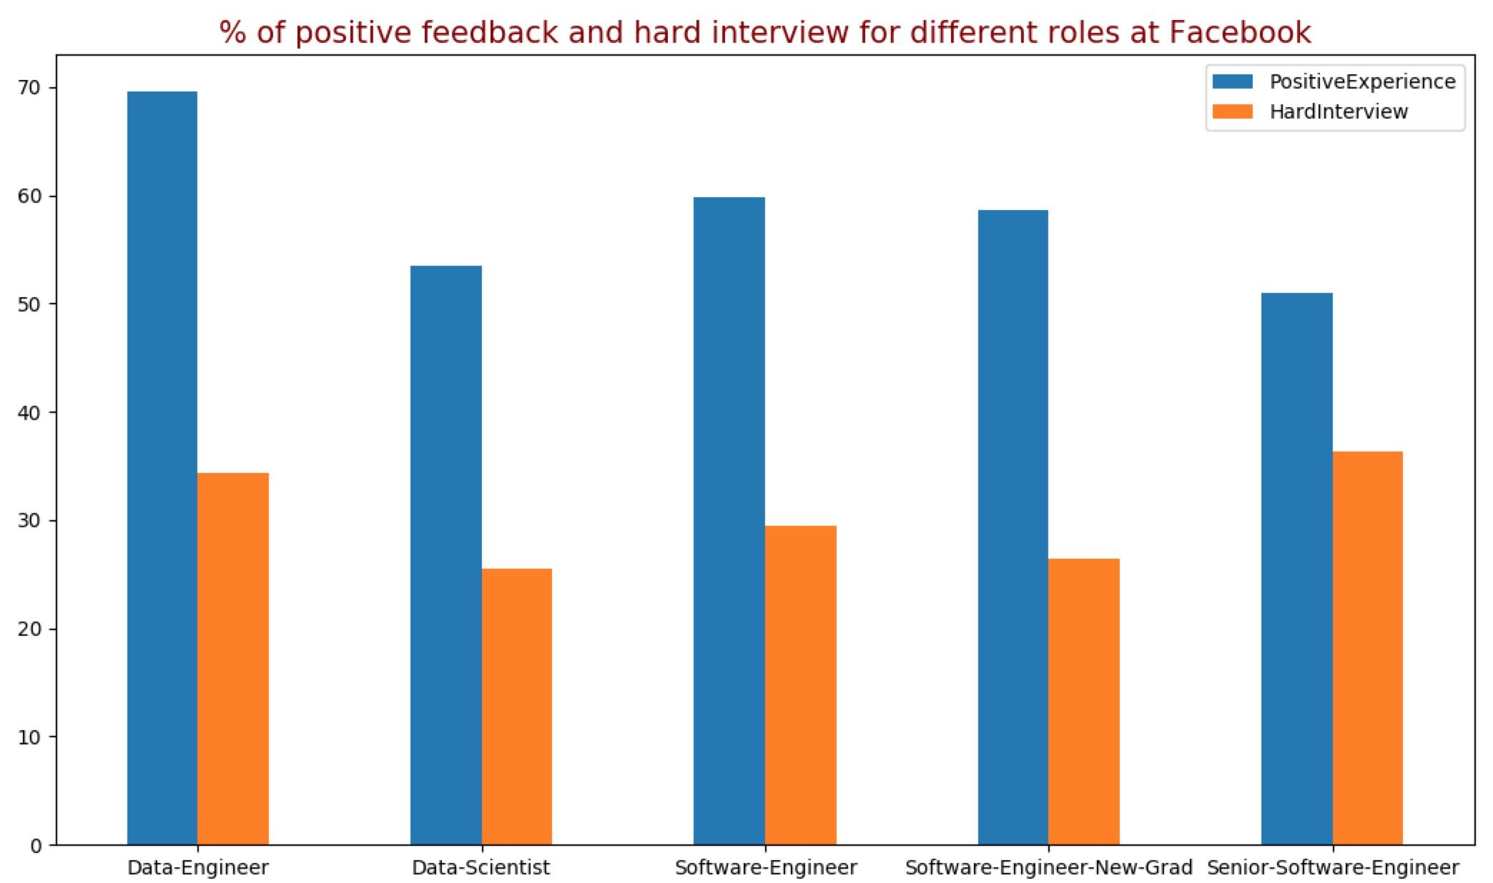
Interview feedback varies wildly even within the same company

Slide 61
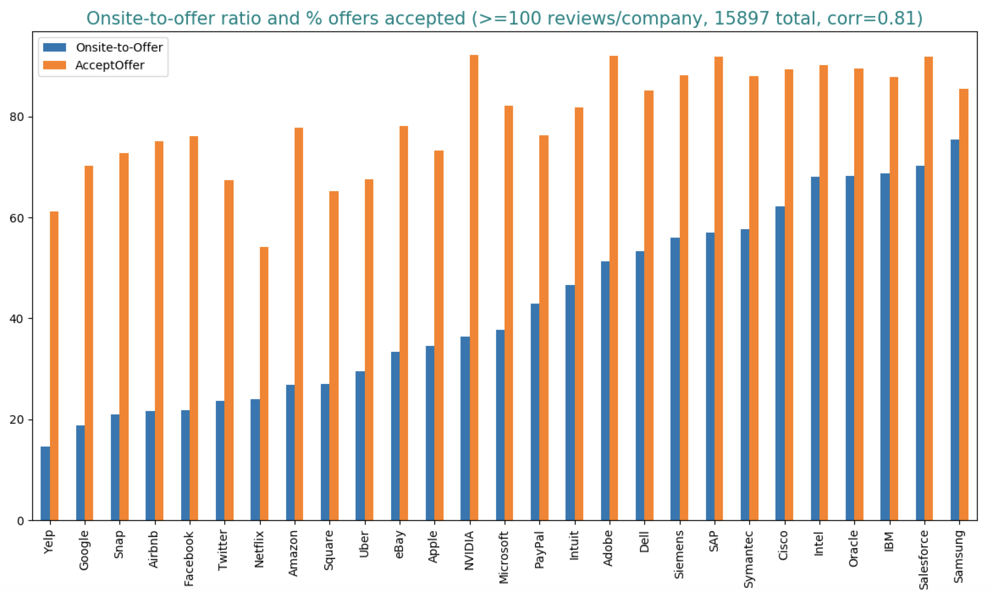
The higher the onsite-to-offer ratio, the more likely offers are accepted
Link to blog post

Slide 62
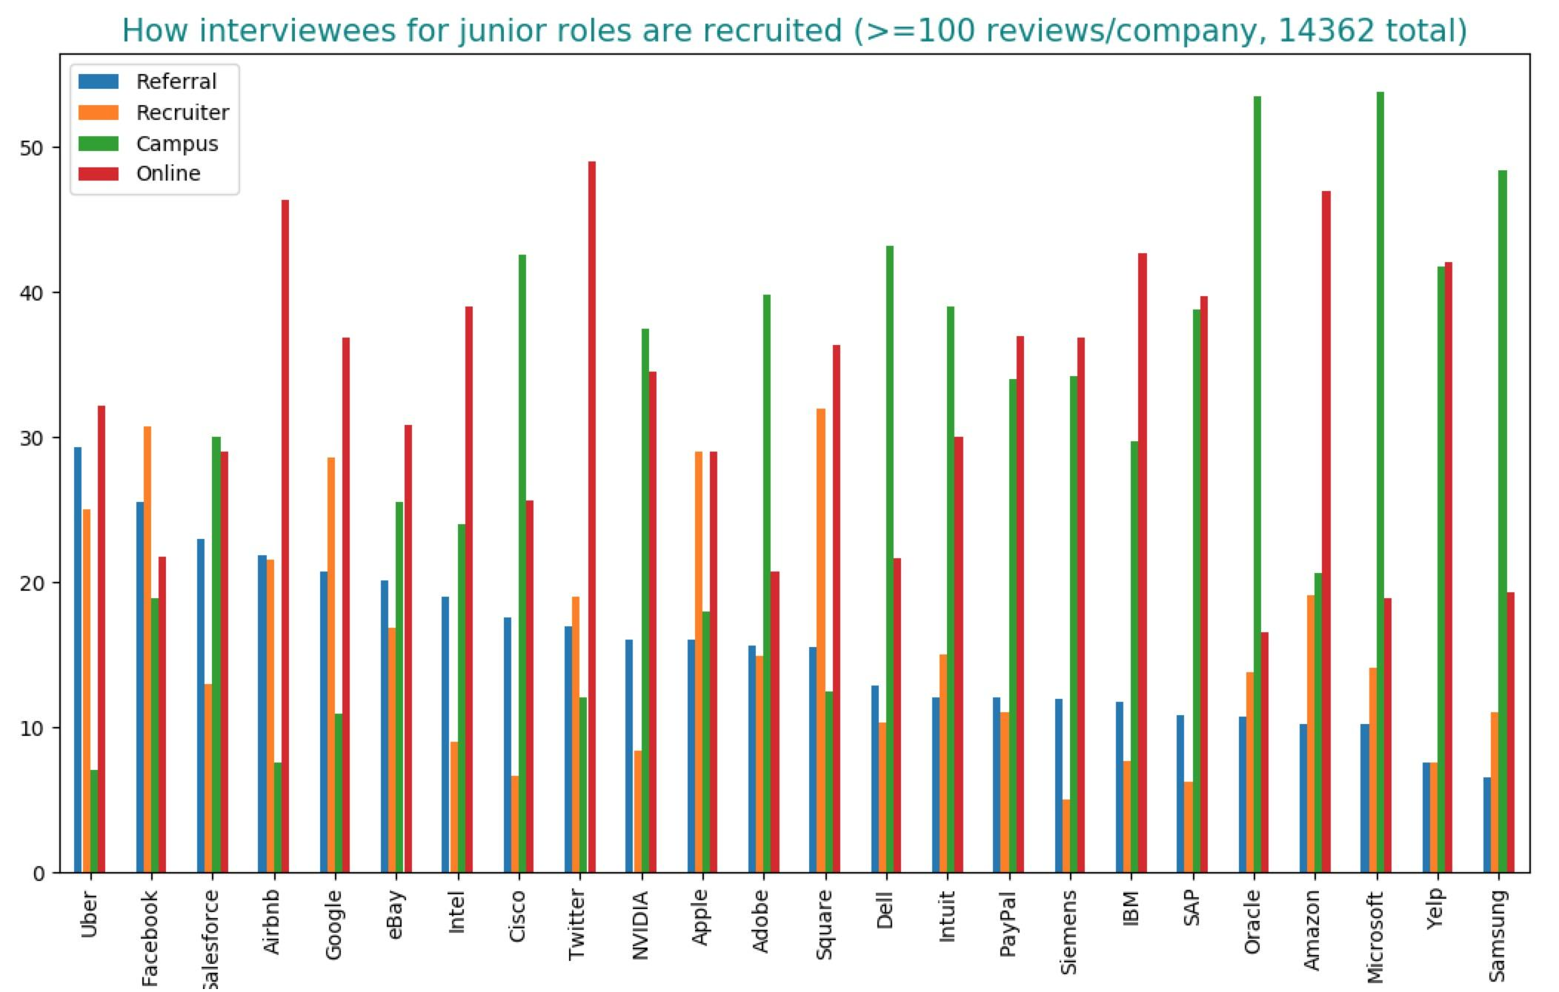
Most junior roles are sourced through campus or referrals

Slide 63
How important are referrals?
“By at least a 10x margin, the best candidate sources I’ve ever seen are friends and friends of friends.”
- Sam Altman (Y Combinator)
“Referral quality was incredibly important – the 8 worst hires … were all unknown to me and everyone at the company at the time of hiring.”
Lukas Biewald (Figure 8, Weights & Biases)

Slide 64
Most junior roles are sourced through campus or referrals
Tech Ivy mixer alert!!!

Slide 65
What if you don’t go to a fancy engineering school or know people who can refer you?

Slide 66
“Be so good they can’t ignore you”
Steve Martin

Slide 67
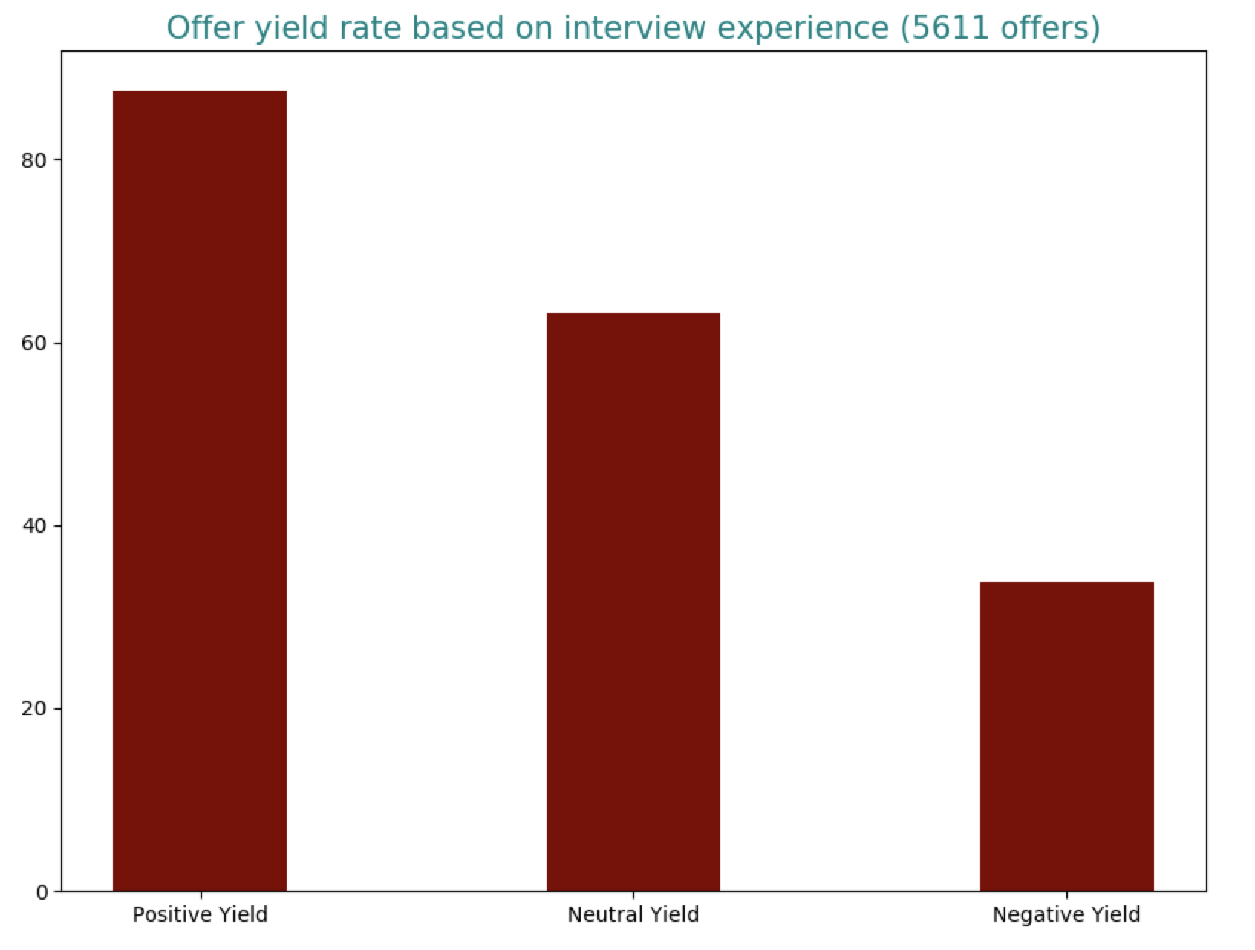
Candidates with negative experience are less likely to accept offers

Slide 68
General tips
Job search and interview preparation are lifelong processes.
The best time to interview is when you don’t need a job.
Start looking for jobs 3-6 months before.
Build up your portfolio and publish them.
Get people to refer you.
Look up your interviewers. Review their work.
Have your friends to give you mock interviews.
Don’t pretend that you know something when you don’t.
Don’t criticize your previous or current employers.
Don’t talk about your age, marital status, religion, political affiliation.
Have competing offers.
Don’t sweat it. If you tank an interview, move on.

Slide 69
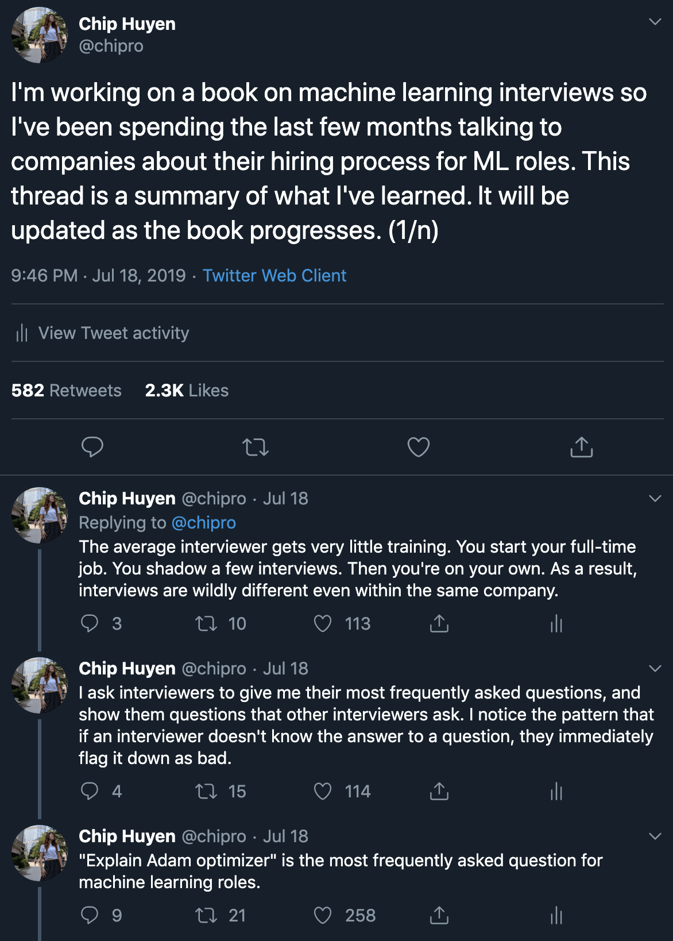
Book info:
huyenchip.com/2019/07/21/machine-learning-interviews.html

Slide 70
Thank you!
chip@huyenchip.com
Twitter: @chipro
Notes:
Q&A

